Slide 1



Board Manager
(Robotics Term-Project)
아노유노
201533650 송석현
201835434 김주현
201835506 임동혁

Slide 2
Index
1. Motivation
2. Main Goal
3. Demo Video
4. System Architecture
5. Sketch Code
6. Value of System
7. Special Point
8. Used Components
9. Future Work
10. Member Role

Slide 3
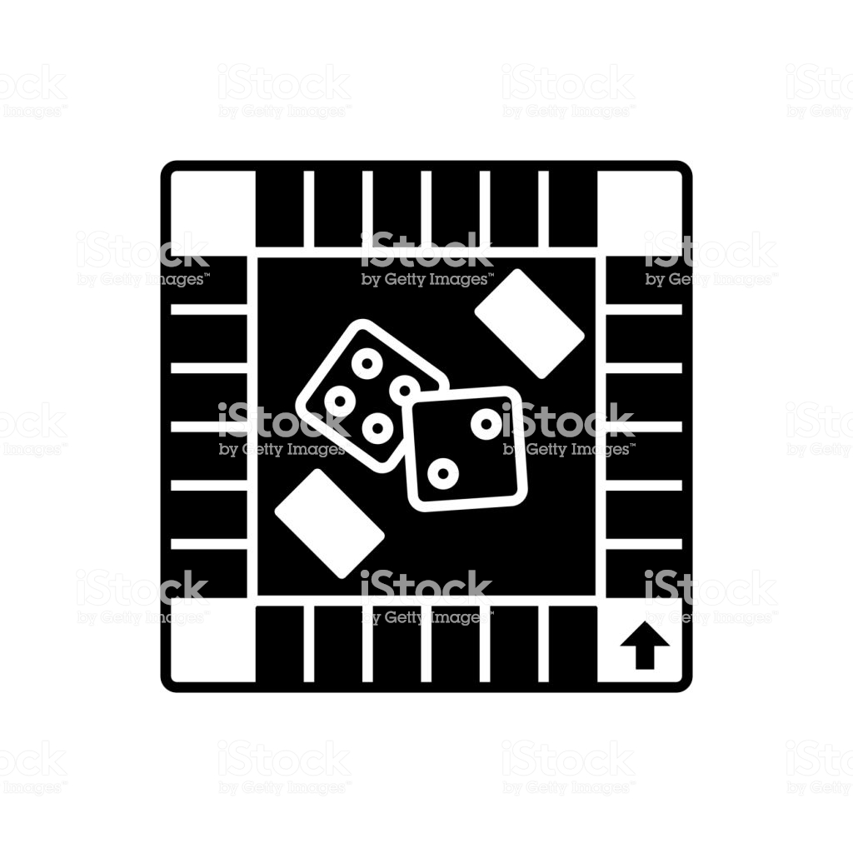



1. Motivation
Too Dizzy to play Board Game!!
??
Roll the Dice!!
Moving the marker!!
What is the mission??
I want to play Board Game!!

Slide 4



2. Main Goal
Automatic
Board Game
Our Own
Board Game
Digital
Board Game
LCD

Slide 5

3. Demo Video
https://youtu.be/AwbF5eb6ghg
Notes:
데모영상 삽입 또는 링크걸기

Slide 6


4. System Architecture
Press the Button!!
How many blocks? Go Marker!!
Turn on the LED!!
How many players??
I want to START Board Game!!

Slide 7
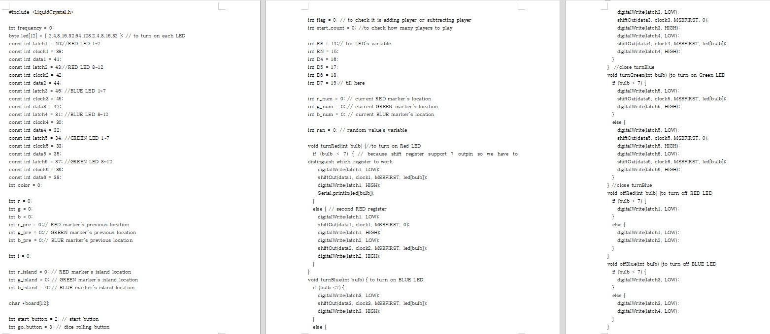
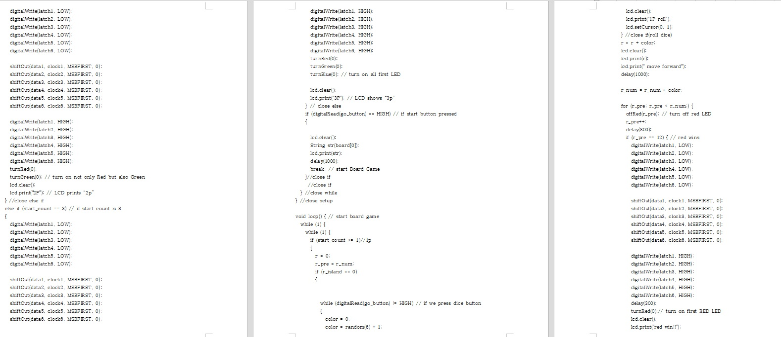
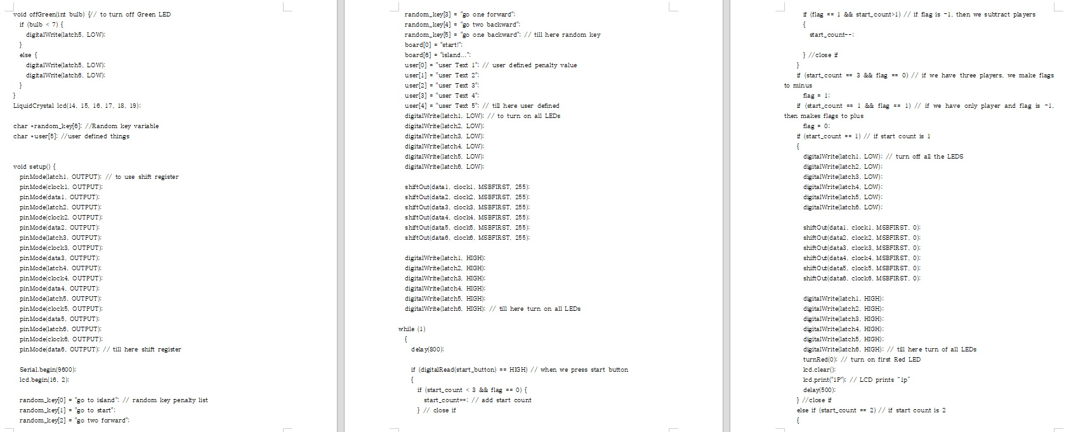
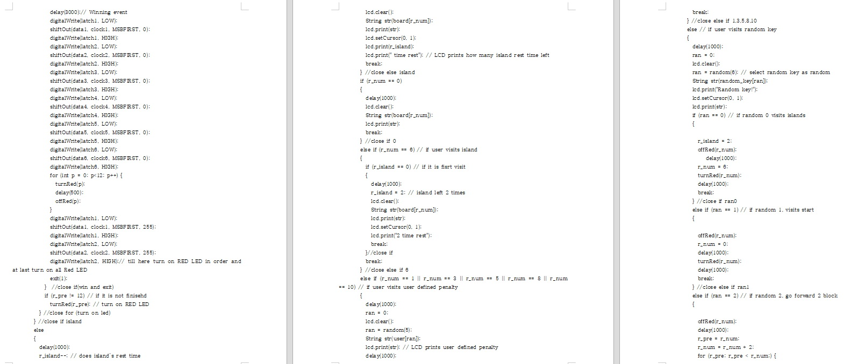
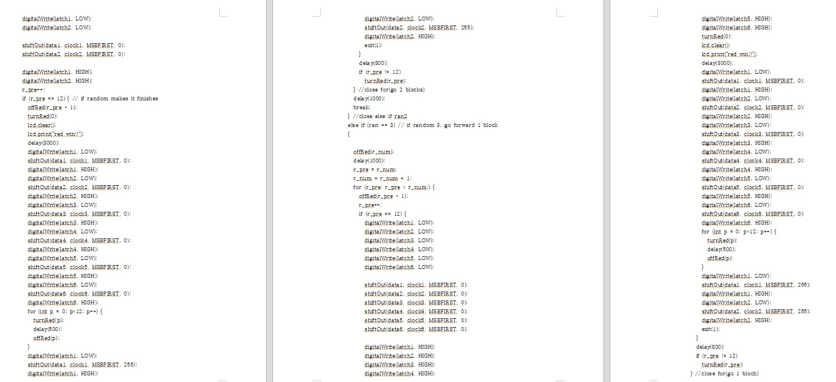
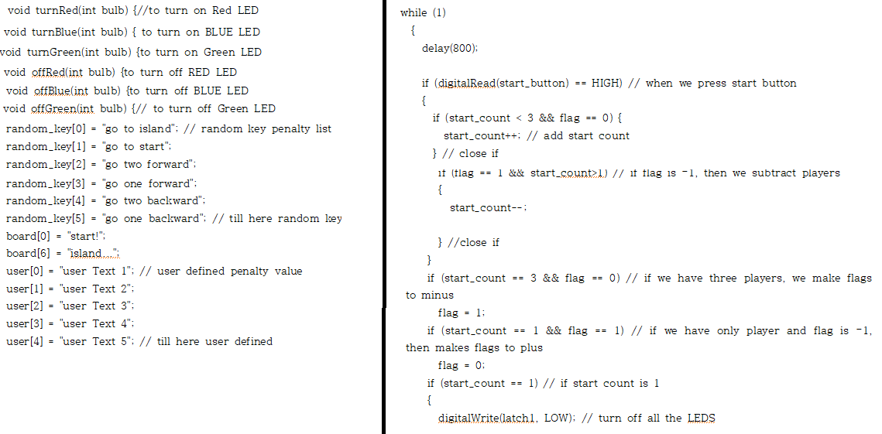
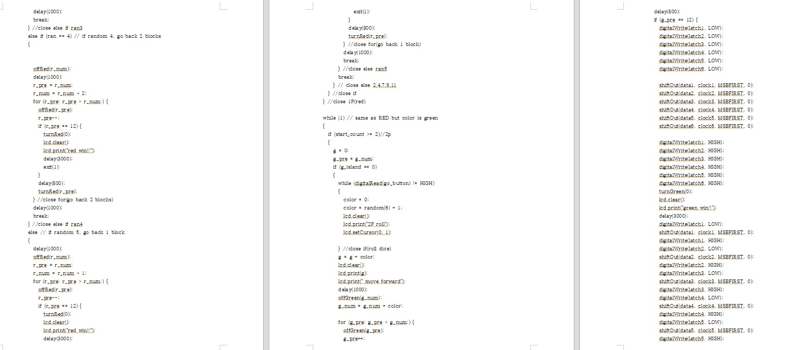
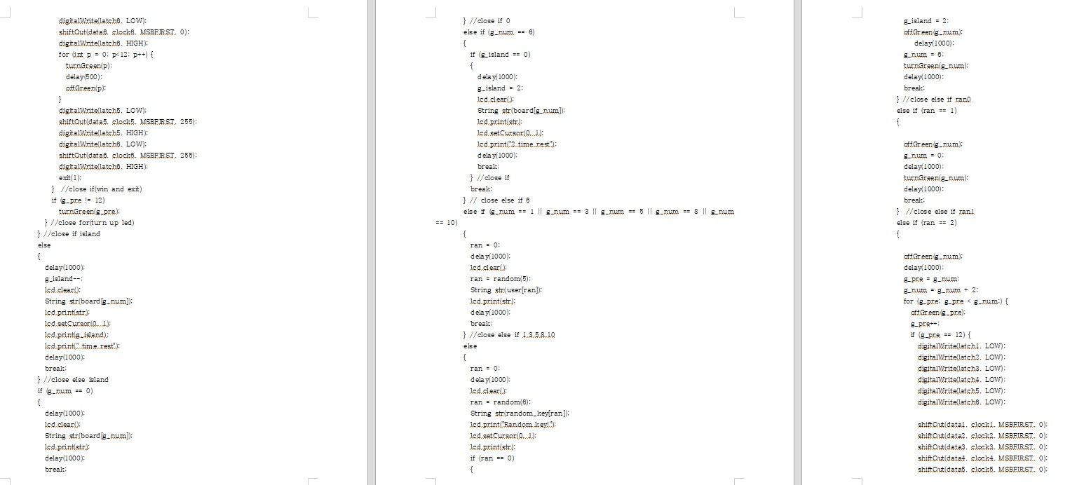
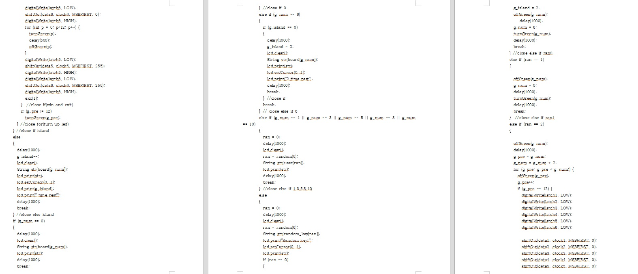
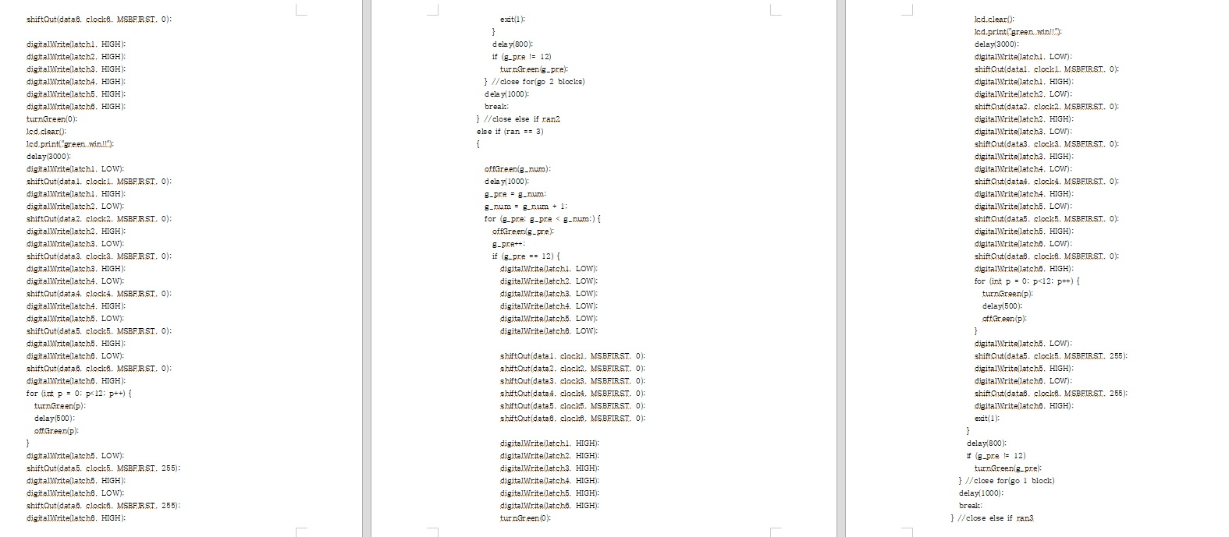
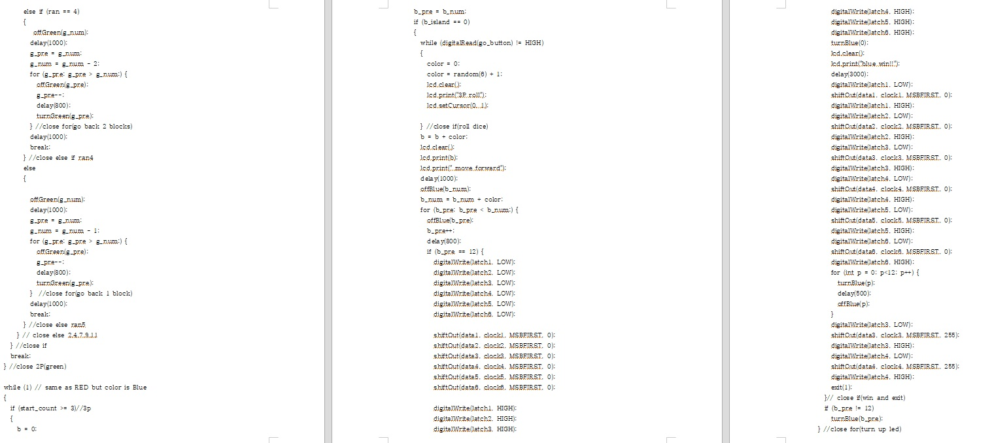
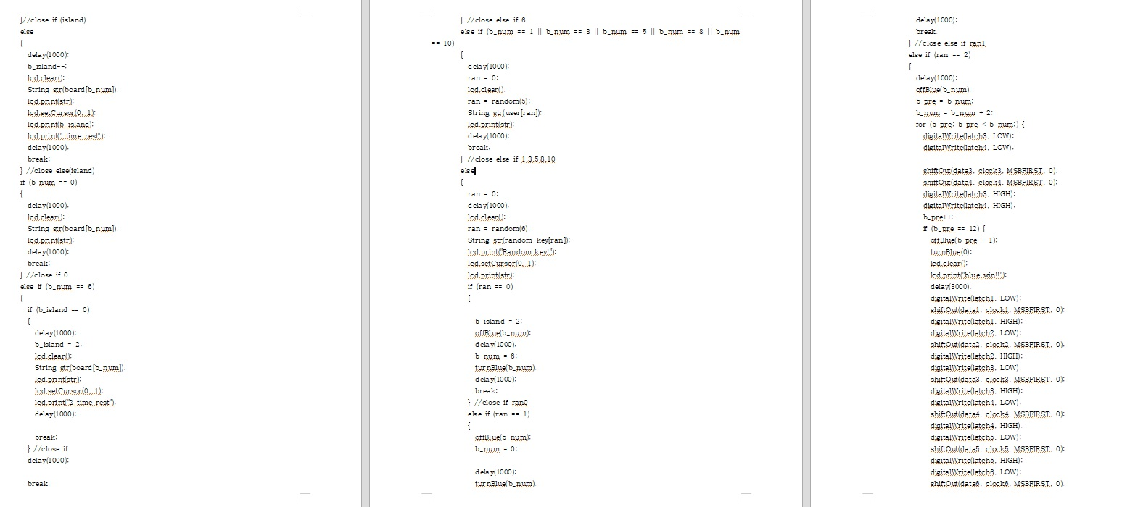
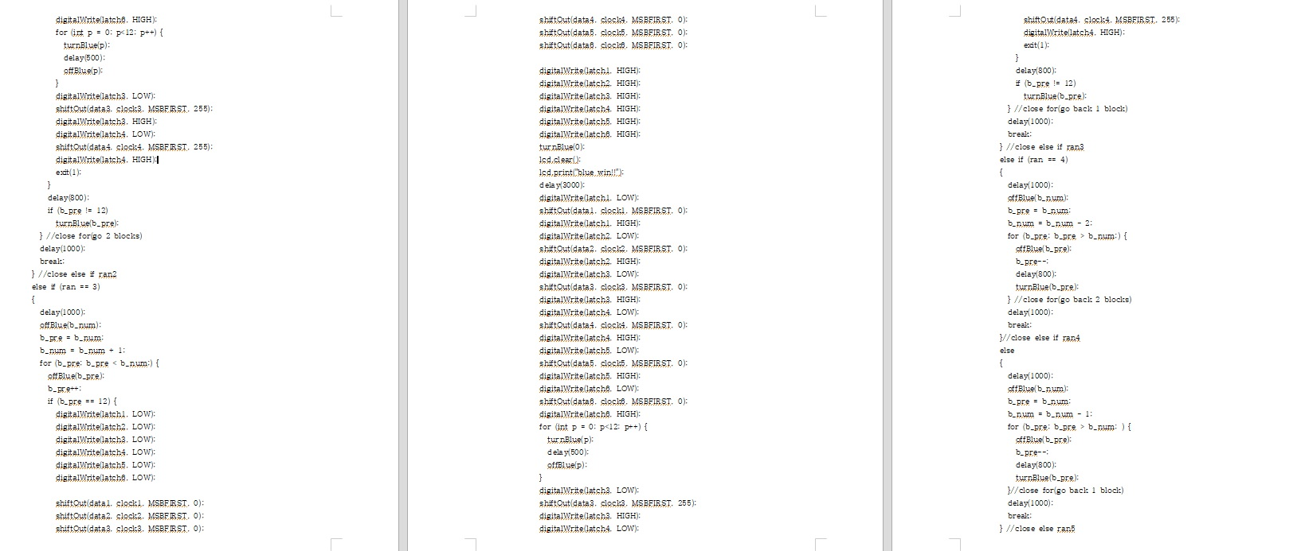
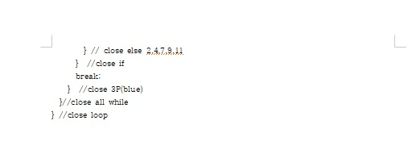
5. Sketch Code

Slide 8
6. Value of System
1 ) Practical aspects
Play without Dice and Marker
LCD Print the Mission and Help Playing
Notes:
실용적인 측면 :
주사위, 말이 필요 없이 단순히 이 판으로 게임을 할 수 있다
내가 원하는 벌칙이나 상을 설정할 수 있다.
LCD에 정해진 벌칙이 출력되고, 현재 주사위 돌리는 플레이어를 출력함으로 플레이를 도와준다.
창의적인 측면
LED가 켜짐으로 말판을 설정하였다.
주사위대신 랜덤함수로 값을 받아 play한다.
random key를 설정하여 이미 설정 된 mission들 중 랜덤으로 mission이 주어지도록 한다.

Slide 9
6. Value of System
2 ) Creative aspects
Move Marker by LED
Random Mission is Printed and Performed
Notes:
실용적인 측면 :
주사위, 말이 필요 없이 단순히 이 판으로 게임을 할 수 있다
내가 원하는 벌칙이나 상을 설정할 수 있다.
LCD에 정해진 벌칙이 출력되고, 현재 주사위 돌리는 플레이어를 출력함으로 플레이를 도와준다.
창의적인 측면
LED가 켜짐으로 말판을 설정하였다.
주사위대신 랜덤함수로 값을 받아 play한다.
random key를 설정하여 이미 설정 된 mission들 중 랜덤으로 mission이 주어지도록 한다.

Slide 10
7. Special points
Adv 1. Play just with this board game manager!
Disadv1. Dice are not visible
Disadv2. Board Manager Needs High voltage
Adv 2. Board game can be various conceps
Notes:
7. 우리 작품의 특이점
장점 : 이 말판만 가지고 보드게임을 플레이 할 수 있다.
자신이 정한 미션에 따라 다양한 컨셉의 보드게임이 될 수 있다.
단점 : 주사위가 돌아가는 것을 가시적으로 보여주지 못한다.
노트북이 있어야 실행이 가능하다.
특별히 부각하고자 하는 점
각각의 LED를 하나씩 아두이노에 연결한 것이 아닌 shift register을 이용하여 한번에 7개의 LED를 제어한다.
버튼과 칸에 설정 된 랜덤값에 따라 앞 뒤 이동을 잘 보여준다. (한칸씩 어떻게 이동하는지 보여준다.)
칸에 미리 써놓은 것이 아닌 입력 된 mission을 random으로 받으면서 LCD에 출력하여 알려줌으로써 같은 칸에 도착해도 다른 결과를 출력 한다.
무인도, 랜덤키, 유저설정 등 다양한 mission 설정.

Slide 11
7. Special points
Spc 1. Control 7 LED at once by Shift Register
Spc 2. Random Mission
Spc 3. Print LCD -> who roll the dice, what mission etc
Spc 4. Various Mission -> Island, Random key etc
Notes:
7. 우리 작품의 특이점
장점 : 이 말판만 가지고 보드게임을 플레이 할 수 있다.
자신이 정한 미션에 따라 다양한 컨셉의 보드게임이 될 수 있다.
단점 : 주사위가 돌아가는 것을 가시적으로 보여주지 못한다.
노트북이 있어야 실행이 가능하다.
특별히 부각하고자 하는 점
각각의 LED를 하나씩 아두이노에 연결한 것이 아닌 shift register을 이용하여 한번에 7개의 LED를 제어한다.
버튼과 칸에 설정 된 랜덤값에 따라 앞 뒤 이동을 잘 보여준다. (한칸씩 어떻게 이동하는지 보여준다.)
칸에 미리 써놓은 것이 아닌 입력 된 mission을 random으로 받으면서 LCD에 출력하여 알려줌으로써 같은 칸에 도착해도 다른 결과를 출력 한다.
무인도, 랜덤키, 유저설정 등 다양한 mission 설정.

Slide 12
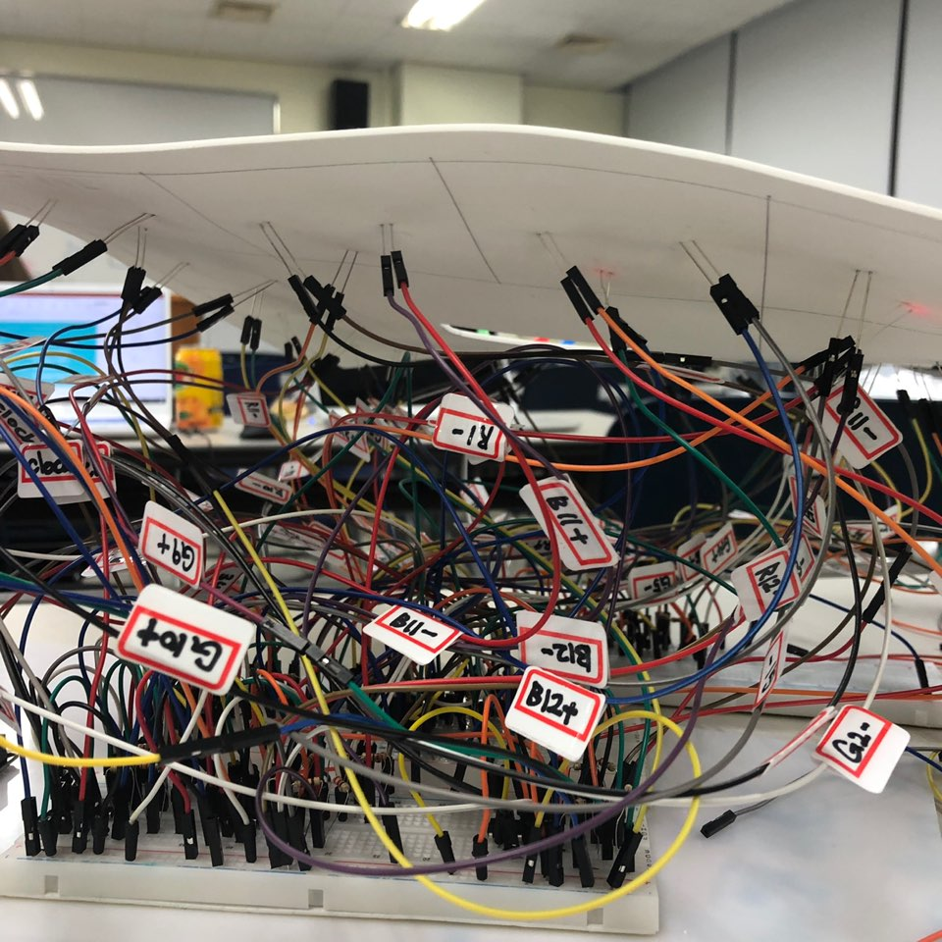
8. Used Components
1 ) Shift Register : expand output digital pins we used shift register
2 ) LCD : shows current board game's status
3 ) Button : setup player's count, the other button is to play board game
4 ) LED : marker moves and LED represent each marker
Notes:
8. 결론

Slide 13
9. Future Work
1 ) bluetooth : we can set user defined penalty as bluetooth, so it can be more dynamic
2 ) color sensor & DC motor : we can roll the dice ourself, and color sensor read the dice's color and set how many blocks to go
Notes:
8. 결론

Slide 14
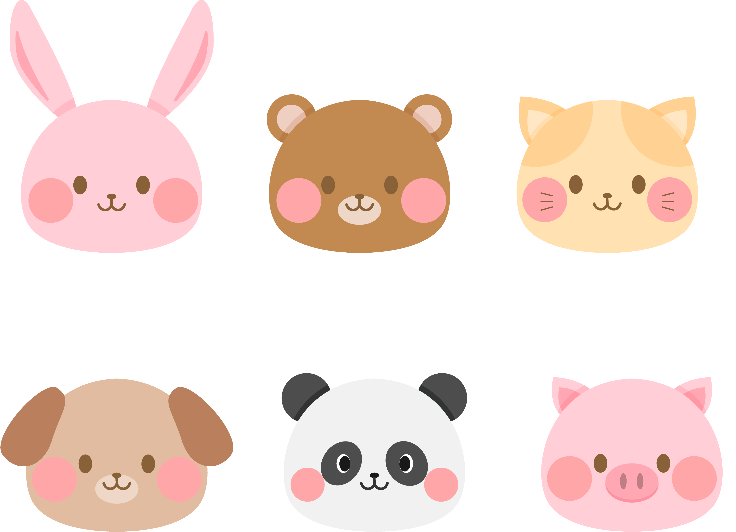
10. Role of Members
Song Seok Hyun
Electric Circuit
Coding
=> 34%
Kim Joo Hyun
- Support Coding
Design
=> 33%
Lim Dong Hyuk
Total Program Coding
=> 33%

Slide 15
#include <LiquidCrystal.h>
int frequency = 0;
byte led[12] = { 2,4,8,16,32,64,128,2,4,8,16,32 }; // to turn on each LED
const int latch1 = 40;//RED LED 1~7
const int clock1 = 39;
const int data1 = 41;
const int latch2 = 43;//RED LED 8~12
const int clock2 = 42;
const int data2 = 44;
const int latch3 = 46; //BLUE LED 1~7
const int clock3 = 45;
const int data3 = 47;
const int latch4 = 31; //BLUE LED 8~12
const int clock4 = 30;
const int data4 = 32;
const int latch5 = 34; //GREEN LED 1~7
const int clock5 = 33;
const int data5 = 35;
const int latch6 = 37; //GREEN LED 8~12
const int clock6 = 36;
const int data6 = 38;
int color = 0;
int r = 0;
int g = 0;
int b = 0;
int r_pre = 0;// RED marker’s previous location
int g_pre = 0;// GREEN marker’s previous location
int b_pre = 0;// BLUE marker’s previous location
int i = 0;
int r_island = 0; // RED marker’s island location
int g_island = 0; // GREEN marker’s island location
int b_island = 0; // BLUE marker’s island location
char *board[12];
int start_button = 2; // start button
int go_button = 3; // dice rolling button
int flag = 0; // to check it is adding player or subtracting player
int start_count = 0; //to check how many players to play
int RS = 14;// for LED’s variable
int EN = 15;
int D4 = 16;
int D5 = 17;
int D6 = 18;
int D7 = 19;// till here
int r_num = 0; // current RED marker’s location
int g_num = 0; // current GREEN marker’s location
int b_num = 0; // current BLUE marker’s location
int ran = 0; // random value’s variable
void turnRed(int bulb) {//to turn on Red LED
if (bulb < 7) { // because shift register support 7 outpin so we have to distinguish which register to work
digitalWrite(latch1, LOW);
shiftOut(data1, clock1, MSBFIRST, led[bulb]);
digitalWrite(latch1, HIGH);
Serial.println(led[bulb]);
}
else { // second RED register
digitalWrite(latch1, LOW);
shiftOut(data1, clock1, MSBFIRST, 0);
digitalWrite(latch1, HIGH);
digitalWrite(latch2, LOW);
shiftOut(data2, clock2, MSBFIRST, led[bulb]);
digitalWrite(latch2, HIGH);
}
}
void turnBlue(int bulb) { to turn on BLUE LED
if (bulb <7) {
digitalWrite(latch3, LOW);
shiftOut(data3, clock3, MSBFIRST, led[bulb]);
digitalWrite(latch3, HIGH);
}
else {
digitalWrite(latch3, LOW);
shiftOut(data3, clock3, MSBFIRST, 0);
digitalWrite(latch3, HIGH);
digitalWrite(latch4, LOW);
shiftOut(data4, clock4, MSBFIRST, led[bulb]);
digitalWrite(latch4, HIGH);
}
} //close turnBlue
void turnGreen(int bulb) {to turn on Green LED
if (bulb < 7) {
digitalWrite(latch5, LOW);
shiftOut(data5, clock5, MSBFIRST, led[bulb]);
digitalWrite(latch5, HIGH);
}
else {
digitalWrite(latch5, LOW);
shiftOut(data5, clock5, MSBFIRST, 0);
digitalWrite(latch5, HIGH);
digitalWrite(latch6, LOW);
shiftOut(data6, clock6, MSBFIRST, led[bulb]);
digitalWrite(latch6, HIGH);
}
} //close turnBlue
void offRed(int bulb) {to turn off RED LED
if (bulb < 7) {
digitalWrite(latch1, LOW);
}
else {
digitalWrite(latch1, LOW);
digitalWrite(latch2, LOW);
}
}
void offBlue(int bulb) {to turn off BLUE LED
if (bulb < 7) {
digitalWrite(latch3, LOW);
}
else {
digitalWrite(latch3, LOW);
digitalWrite(latch4, LOW);
}
}
void offGreen(int bulb) {// to turn off Green LED
if (bulb < 7) {
digitalWrite(latch5, LOW);
}
else {
digitalWrite(latch5, LOW);
digitalWrite(latch6, LOW);
}
}
LiquidCrystal lcd(14, 15, 16, 17, 18, 19);
char *random_key[6]; //Random key variable
char *user[5]; //user defined things
void setup() {
pinMode(latch1, OUTPUT); // to use shift register
pinMode(clock1, OUTPUT);
pinMode(data1, OUTPUT);
pinMode(latch2, OUTPUT);
pinMode(clock2, OUTPUT);
pinMode(data2, OUTPUT);
pinMode(latch3, OUTPUT);
pinMode(clock3, OUTPUT);
pinMode(data3, OUTPUT);
pinMode(latch4, OUTPUT);
pinMode(clock4, OUTPUT);
pinMode(data4, OUTPUT);
pinMode(latch5, OUTPUT);
pinMode(clock5, OUTPUT);
pinMode(data5, OUTPUT);
pinMode(latch6, OUTPUT);
pinMode(clock6, OUTPUT);
pinMode(data6, OUTPUT); // till here shift register
Serial.begin(9600);
lcd.begin(16, 2);
random_key[0] = "go to island"; // random key penalty list
random_key[1] = "go to start";
random_key[2] = "go two forward";
random_key[3] = "go one forward";
random_key[4] = "go two backward";
random_key[5] = "go one backward"; // till here random key
board[0] = "start!";
board[6] = "island...";
user[0] = "user Text 1"; // user defined penalty value
user[1] = "user Text 2";
user[2] = "user Text 3";
user[3] = "user Text 4";
user[4] = "user Text 5"; // till here user defined
digitalWrite(latch1, LOW); // to turn on all LEDs
digitalWrite(latch2, LOW);
digitalWrite(latch3, LOW);
digitalWrite(latch4, LOW);
digitalWrite(latch5, LOW);
digitalWrite(latch6, LOW);
shiftOut(data1, clock1, MSBFIRST, 255);
shiftOut(data2, clock2, MSBFIRST, 255);
shiftOut(data3, clock3, MSBFIRST, 255);
shiftOut(data4, clock4, MSBFIRST, 255);
shiftOut(data5, clock5, MSBFIRST, 255);
shiftOut(data6, clock6, MSBFIRST, 255);
digitalWrite(latch1, HIGH);
digitalWrite(latch2, HIGH);
digitalWrite(latch3, HIGH);
digitalWrite(latch4, HIGH);
digitalWrite(latch5, HIGH);
digitalWrite(latch6, HIGH); // till here turn on all LEDs
while (1)
{
delay(800);
if (digitalRead(start_button) == HIGH) // when we press start button
{
if (start_count < 3 && flag == 0) {
start_count++; // add start count
} // close if
if (flag == 1 && start_count>1) // if flag is –1, then we subtract players
{
start_count--;
} //close if
}
if (start_count == 3 && flag == 0) // if we have three players, we make flags to minus
flag = 1;
if (start_count == 1 && flag == 1) // if we have only player and flag is –1, then makes flags to plus
flag = 0;
if (start_count == 1) // if start count is 1
{
digitalWrite(latch1, LOW); // turn off all the LEDS
digitalWrite(latch2, LOW);
digitalWrite(latch3, LOW);
digitalWrite(latch4, LOW);
digitalWrite(latch5, LOW);
digitalWrite(latch6, LOW);
shiftOut(data1, clock1, MSBFIRST, 0);
shiftOut(data2, clock2, MSBFIRST, 0);
shiftOut(data3, clock3, MSBFIRST, 0);
shiftOut(data4, clock4, MSBFIRST, 0);
shiftOut(data5, clock5, MSBFIRST, 0);
shiftOut(data6, clock6, MSBFIRST, 0);
digitalWrite(latch1, HIGH);
digitalWrite(latch2, HIGH);
digitalWrite(latch3, HIGH);
digitalWrite(latch4, HIGH);
digitalWrite(latch5, HIGH);
digitalWrite(latch6, HIGH); // till here turn of all LEDs
turnRed(0); // turn on first Red LED
lcd.clear();
lcd.print("1P"); // LCD prints “1p”
delay(500);
} //close if
else if (start_count == 2) // if start count is 2
{
digitalWrite(latch1, LOW);
digitalWrite(latch2, LOW);
digitalWrite(latch3, LOW);
digitalWrite(latch4, LOW);
digitalWrite(latch5, LOW);
digitalWrite(latch6, LOW);
shiftOut(data1, clock1, MSBFIRST, 0);
shiftOut(data2, clock2, MSBFIRST, 0);
shiftOut(data3, clock3, MSBFIRST, 0);
shiftOut(data4, clock4, MSBFIRST, 0);
shiftOut(data5, clock5, MSBFIRST, 0);
shiftOut(data6, clock6, MSBFIRST, 0);
digitalWrite(latch1, HIGH);
digitalWrite(latch2, HIGH);
digitalWrite(latch3, HIGH);
digitalWrite(latch4, HIGH);
digitalWrite(latch5, HIGH);
digitalWrite(latch6, HIGH);
turnRed(0);
turnGreen(0); // turn on not only Red but also Green
lcd.clear();
lcd.print("2P"); // LCD prints “2p”
} //close else if
else if (start_count == 3) // if start count is 3
{
digitalWrite(latch1, LOW);
digitalWrite(latch2, LOW);
digitalWrite(latch3, LOW);
digitalWrite(latch4, LOW);
digitalWrite(latch5, LOW);
digitalWrite(latch6, LOW);
shiftOut(data1, clock1, MSBFIRST, 0);
shiftOut(data2, clock2, MSBFIRST, 0);
shiftOut(data3, clock3, MSBFIRST, 0);
shiftOut(data4, clock4, MSBFIRST, 0);
shiftOut(data5, clock5, MSBFIRST, 0);
shiftOut(data6, clock6, MSBFIRST, 0);
digitalWrite(latch1, HIGH);
digitalWrite(latch2, HIGH);
digitalWrite(latch3, HIGH);
digitalWrite(latch4, HIGH);
digitalWrite(latch5, HIGH);
digitalWrite(latch6, HIGH);
turnRed(0);
turnGreen(0);
turnBlue(0); // turn on all first LED
lcd.clear();
lcd.print("3P"); // LCD shows “3p”
} // close else
if (digitalRead(go_button) == HIGH) // if start button pressed
{
lcd.clear();
String str(board[0]);
lcd.print(str);
delay(1000);
break; // start Board Game
}//close if
//close if
} //close while
} //close setup
void loop() { // start board game
while (1) {
while (1) {
if (start_count >= 1)//1p
{
r = 0;
r_pre = r_num;
if (r_island == 0)
{
while (digitalRead(go_button) != HIGH) // if we press dice button
{
color = 0;
color = random(6) + 1;
lcd.clear();
lcd.print("1P roll");
lcd.setCursor(0, 1);
} //close if(roll dice)
r = r + color;
lcd.clear();
lcd.print(r);
lcd.print(" move forward");
delay(1000);
r_num = r_num + color;
for (r_pre; r_pre < r_num;) {
offRed(r_pre); // turn off red LED
r_pre++;
delay(800);
if (r_pre == 12) { // red wins
digitalWrite(latch1, LOW);
digitalWrite(latch2, LOW);
digitalWrite(latch3, LOW);
digitalWrite(latch4, LOW);
digitalWrite(latch5, LOW);
digitalWrite(latch6, LOW);
shiftOut(data1, clock1, MSBFIRST, 0);
shiftOut(data2, clock2, MSBFIRST, 0);
shiftOut(data3, clock3, MSBFIRST, 0);
shiftOut(data4, clock4, MSBFIRST, 0);
shiftOut(data5, clock5, MSBFIRST, 0);
shiftOut(data6, clock6, MSBFIRST, 0);
digitalWrite(latch1, HIGH);
digitalWrite(latch2, HIGH);
digitalWrite(latch3, HIGH);
digitalWrite(latch4, HIGH);
digitalWrite(latch5, HIGH);
digitalWrite(latch6, HIGH);
delay(300);
turnRed(0);// turn on first RED LED
lcd.clear();
lcd.print("red win!!");
delay(3000);// Winning event
digitalWrite(latch1, LOW);
shiftOut(data1, clock1, MSBFIRST, 0);
digitalWrite(latch1, HIGH);
digitalWrite(latch2, LOW);
shiftOut(data2, clock2, MSBFIRST, 0);
digitalWrite(latch2, HIGH);
digitalWrite(latch3, LOW);
shiftOut(data3, clock3, MSBFIRST, 0);
digitalWrite(latch3, HIGH);
digitalWrite(latch4, LOW);
shiftOut(data4, clock4, MSBFIRST, 0);
digitalWrite(latch4, HIGH);
digitalWrite(latch5, LOW);
shiftOut(data5, clock5, MSBFIRST, 0);
digitalWrite(latch5, HIGH);
digitalWrite(latch6, LOW);
shiftOut(data6, clock6, MSBFIRST, 0);
digitalWrite(latch6, HIGH);
for (int p = 0; p<12; p++) {
turnRed(p);
delay(500);
offRed(p);
}
digitalWrite(latch1, LOW);
shiftOut(data1, clock1, MSBFIRST, 255);
digitalWrite(latch1, HIGH);
digitalWrite(latch2, LOW);
shiftOut(data2, clock2, MSBFIRST, 255);
digitalWrite(latch2, HIGH);// till here turn on RED LED in order and at last turn on all Red LED
exit(1);
} //close if(win and exit)
if (r_pre != 12) // if it is not finisehd
turnRed(r_pre); // turn on RED LED
} //close for (turn on led)
} //close if island
else
{
delay(1000);
r_island--; // does island’s rest time
lcd.clear();
String str(board[r_num]);
lcd.print(str);
lcd.setCursor(0, 1);
lcd.print(r_island);
lcd.print(" time rest"); // LCD prints how many island rest time left
break;
} //close else island
if (r_num == 0)
{
delay(1000);
lcd.clear();
String str(board[r_num]);
lcd.print(str);
break;
} //close if 0
else if (r_num == 6) // if user visits island
{
if (r_island == 0) // if it is fisrt visit
{
delay(1000);
r_island = 2; // island left 2 times
lcd.clear();
String str(board[r_num]);
lcd.print(str);
lcd.setCursor(0, 1);
lcd.print("2 time rest");
break;
}//close if
break;
} //close else if 6
else if (r_num == 1 || r_num == 3 || r_num == 5 || r_num == 8 || r_num == 10) // if user visits user defined penalty
{
delay(1000);
ran = 0;
lcd.clear();
ran = random(5);
String str(user[ran]);
lcd.print(str); // LCD prints user defined penalty
delay(1000);
break;
} //close else if 1,3,5,8,10
else // if user visits random key
{
delay(1000);
ran = 0;
lcd.clear();
ran = random(6); // select random key as random
String str(random_key[ran]);
lcd.print("Random key!");
lcd.setCursor(0, 1);
lcd.print(str);
if (ran == 0) // if random 0 visits islands
{
r_island = 2;
offRed(r_num);
delay(1000);
r_num = 6;
turnRed(r_num);
delay(1000);
break;
} //close if ran0
else if (ran == 1) // if random 1, visits start
{
offRed(r_num);
r_num = 0;
delay(1000);
turnRed(r_num);
delay(1000);
break;
} //close else if ran1
else if (ran == 2) // if random 2, go forward 2 block
{
offRed(r_num);
delay(1000);
r_pre = r_num;
r_num = r_num + 2;
for (r_pre; r_pre < r_num;) {
digitalWrite(latch1, LOW);
digitalWrite(latch2, LOW);
shiftOut(data1, clock1, MSBFIRST, 0);
shiftOut(data2, clock2, MSBFIRST, 0);
digitalWrite(latch1, HIGH);
digitalWrite(latch2, HIGH);
r_pre++;
if (r_pre == 12) { // if random makes it finishes
offRed(r_pre - 1);
turnRed(0);
lcd.clear();
lcd.print("red win!!");
delay(3000);
digitalWrite(latch1, LOW);
shiftOut(data1, clock1, MSBFIRST, 0);
digitalWrite(latch1, HIGH);
digitalWrite(latch2, LOW);
shiftOut(data2, clock2, MSBFIRST, 0);
digitalWrite(latch2, HIGH);
digitalWrite(latch3, LOW);
shiftOut(data3, clock3, MSBFIRST, 0);
digitalWrite(latch3, HIGH);
digitalWrite(latch4, LOW);
shiftOut(data4, clock4, MSBFIRST, 0);
digitalWrite(latch4, HIGH);
digitalWrite(latch5, LOW);
shiftOut(data5, clock5, MSBFIRST, 0);
digitalWrite(latch5, HIGH);
digitalWrite(latch6, LOW);
shiftOut(data6, clock6, MSBFIRST, 0);
digitalWrite(latch6, HIGH);
for (int p = 0; p<12; p++) {
turnRed(p);
delay(500);
offRed(p);
}
digitalWrite(latch1, LOW);
shiftOut(data1, clock1, MSBFIRST, 255);
digitalWrite(latch1, HIGH);
digitalWrite(latch2, LOW);
shiftOut(data2, clock2, MSBFIRST, 255);
digitalWrite(latch2, HIGH);
exit(1);
}
delay(800);
if (r_pre != 12)
turnRed(r_pre);
} //close for(go 2 blocks)
delay(1000);
break;
} //close else if ran2
else if (ran == 3) // if random 3, go forward 1 block
{
offRed(r_num);
delay(1000);
r_pre = r_num;
r_num = r_num + 1;
for (r_pre; r_pre < r_num;) {
offRed(r_pre - 1);
r_pre++;
if (r_pre == 12) {
digitalWrite(latch1, LOW);
digitalWrite(latch2, LOW);
digitalWrite(latch3, LOW);
digitalWrite(latch4, LOW);
digitalWrite(latch5, LOW);
digitalWrite(latch6, LOW);
shiftOut(data1, clock1, MSBFIRST, 0);
shiftOut(data2, clock2, MSBFIRST, 0);
shiftOut(data3, clock3, MSBFIRST, 0);
shiftOut(data4, clock4, MSBFIRST, 0);
shiftOut(data5, clock5, MSBFIRST, 0);
shiftOut(data6, clock6, MSBFIRST, 0);
digitalWrite(latch1, HIGH);
digitalWrite(latch2, HIGH);
digitalWrite(latch3, HIGH);
digitalWrite(latch4, HIGH);
digitalWrite(latch5, HIGH);
digitalWrite(latch6, HIGH);
turnRed(0);
lcd.clear();
lcd.print("red win!!");
delay(3000);
digitalWrite(latch1, LOW);
shiftOut(data1, clock1, MSBFIRST, 0);
digitalWrite(latch1, HIGH);
digitalWrite(latch2, LOW);
shiftOut(data2, clock2, MSBFIRST, 0);
digitalWrite(latch2, HIGH);
digitalWrite(latch3, LOW);
shiftOut(data3, clock3, MSBFIRST, 0);
digitalWrite(latch3, HIGH);
digitalWrite(latch4, LOW);
shiftOut(data4, clock4, MSBFIRST, 0);
digitalWrite(latch4, HIGH);
digitalWrite(latch5, LOW);
shiftOut(data5, clock5, MSBFIRST, 0);
digitalWrite(latch5, HIGH);
digitalWrite(latch6, LOW);
shiftOut(data6, clock6, MSBFIRST, 0);
digitalWrite(latch6, HIGH);
for (int p = 0; p<12; p++) {
turnRed(p);
delay(500);
offRed(p);
}
digitalWrite(latch1, LOW);
shiftOut(data1, clock1, MSBFIRST, 255);
digitalWrite(latch1, HIGH);
digitalWrite(latch2, LOW);
shiftOut(data2, clock2, MSBFIRST, 255);
digitalWrite(latch2, HIGH);
exit(1);
}
delay(800);
if (r_pre != 12)
turnRed(r_pre);
} //close for(go 1 block)
delay(1000);
break;
} //close else if ran3
else if (ran == 4) // if random 4, go back 2 blocks
{
offRed(r_num);
delay(1000);
r_pre = r_num;
r_num = r_num - 2;
for (r_pre; r_pre > r_num;) {
offRed(r_pre);
r_pre--;
if (r_pre == 12) {
turnRed(0);
lcd.clear();
lcd.print("red win!!");
delay(3000);
exit(1);
}
delay(800);
turnRed(r_pre);
} //close for(go back 2 blocks)
delay(1000);
break;
} //close else if ran4
else // if random 5, go back 1 block
{
delay(1000);
offRed(r_num);
r_pre = r_num;
r_num = r_num - 1;
for (r_pre; r_pre > r_num;) {
offRed(r_pre);
r_pre--;
if (r_pre == 12) {
turnRed(0);
lcd.clear();
lcd.print("red win!!");
delay(3000);
exit(1);
}
delay(800);
turnRed(r_pre);
} //close for(go back 1 block)
delay(1000);
break;
} //close else ran5
break;
} // close else 2,4,7,9,11
} //close if
} //close 1P(red)
while (1) // same as RED but color is green
{
if (start_count >= 2)//2p
{
g = 0;
g_pre = g_num;
if (g_island == 0)
{
while (digitalRead(go_button) != HIGH)
{
color = 0;
color = random(6) + 1;
lcd.clear();
lcd.print("2P roll");
lcd.setCursor(0, 1);
} //close if(roll dice)
g = g + color;
lcd.clear();
lcd.print(g);
lcd.print(" move forward");
delay(1000);
offGreen(g_num);
g_num = g_num + color;
for (g_pre; g_pre < g_num;) {
offGreen(g_pre);
g_pre++;
delay(800);
if (g_pre == 12) {
digitalWrite(latch1, LOW);
digitalWrite(latch2, LOW);
digitalWrite(latch3, LOW);
digitalWrite(latch4, LOW);
digitalWrite(latch5, LOW);
digitalWrite(latch6, LOW);
shiftOut(data1, clock1, MSBFIRST, 0);
shiftOut(data2, clock2, MSBFIRST, 0);
shiftOut(data3, clock3, MSBFIRST, 0);
shiftOut(data4, clock4, MSBFIRST, 0);
shiftOut(data5, clock5, MSBFIRST, 0);
shiftOut(data6, clock6, MSBFIRST, 0);
digitalWrite(latch1, HIGH);
digitalWrite(latch2, HIGH);
digitalWrite(latch3, HIGH);
digitalWrite(latch4, HIGH);
digitalWrite(latch5, HIGH);
digitalWrite(latch6, HIGH);
turnGreen(0);
lcd.clear();
lcd.print("green win!!");
delay(3000);
digitalWrite(latch1, LOW);
shiftOut(data1, clock1, MSBFIRST, 0);
digitalWrite(latch1, HIGH);
digitalWrite(latch2, LOW);
shiftOut(data2, clock2, MSBFIRST, 0);
digitalWrite(latch2, HIGH);
digitalWrite(latch3, LOW);
shiftOut(data3, clock3, MSBFIRST, 0);
digitalWrite(latch3, HIGH);
digitalWrite(latch4, LOW);
shiftOut(data4, clock4, MSBFIRST, 0);
digitalWrite(latch4, HIGH);
digitalWrite(latch5, LOW);
shiftOut(data5, clock5, MSBFIRST, 0);
digitalWrite(latch5, HIGH);
digitalWrite(latch6, LOW);
shiftOut(data6, clock6, MSBFIRST, 0);
digitalWrite(latch6, HIGH);
for (int p = 0; p<12; p++) {
turnGreen(p);
delay(500);
offGreen(p);
}
digitalWrite(latch5, LOW);
shiftOut(data5, clock5, MSBFIRST, 255);
digitalWrite(latch5, HIGH);
digitalWrite(latch6, LOW);
shiftOut(data6, clock6, MSBFIRST, 255);
digitalWrite(latch6, HIGH);
exit(1);
} //close if(win and exit)
if (g_pre != 12)
turnGreen(g_pre);
} //close for(turn up led)
} //close if island
else
{
delay(1000);
g_island--;
lcd.clear();
String str(board[g_num]);
lcd.print(str);
lcd.setCursor(0, 1);
lcd.print(g_island);
lcd.print(" time rest");
delay(1000);
break;
} //close else island
if (g_num == 0)
{
delay(1000);
lcd.clear();
String str(board[g_num]);
lcd.print(str);
delay(1000);
break;
} //close if 0
else if (g_num == 6)
{
if (g_island == 0)
{
delay(1000);
g_island = 2;
lcd.clear();
String str(board[g_num]);
lcd.print(str);
lcd.setCursor(0, 1);
lcd.print("2 time rest");
delay(1000);
break;
} //close if
break;
} // close else if 6
else if (g_num == 1 || g_num == 3 || g_num == 5 || g_num == 8 || g_num == 10)
{
ran = 0;
delay(1000);
lcd.clear();
ran = random(5);
String str(user[ran]);
lcd.print(str);
delay(1000);
break;
} //close else if 1,3,5,8,10
else
{
ran = 0;
delay(1000);
lcd.clear();
ran = random(6);
String str(random_key[ran]);
lcd.print("Random key!");
lcd.setCursor(0, 1);
lcd.print(str);
if (ran == 0)
{
g_island = 2;
offGreen(g_num);
delay(1000);
g_num = 6;
turnGreen(g_num);
delay(1000);
break;
} //close else if ran0
else if (ran == 1)
{
offGreen(g_num);
g_num = 0;
delay(1000);
turnGreen(g_num);
delay(1000);
break;
} //close else if ran1
else if (ran == 2)
{
offGreen(g_num);
delay(1000);
g_pre = g_num;
g_num = g_num + 2;
for (g_pre; g_pre < g_num;) {
offGreen(g_pre);
g_pre++;
if (g_pre == 12) {
digitalWrite(latch1, LOW);
digitalWrite(latch2, LOW);
digitalWrite(latch3, LOW);
digitalWrite(latch4, LOW);
digitalWrite(latch5, LOW);
digitalWrite(latch6, LOW);
shiftOut(data1, clock1, MSBFIRST, 0);
shiftOut(data2, clock2, MSBFIRST, 0);
shiftOut(data3, clock3, MSBFIRST, 0);
shiftOut(data4, clock4, MSBFIRST, 0);
shiftOut(data5, clock5, MSBFIRST, 0);
shiftOut(data6, clock6, MSBFIRST, 0);
digitalWrite(latch1, HIGH);
digitalWrite(latch2, HIGH);
digitalWrite(latch3, HIGH);
digitalWrite(latch4, HIGH);
digitalWrite(latch5, HIGH);
digitalWrite(latch6, HIGH);
turnGreen(0);
lcd.clear();
lcd.print("green win!!");
delay(3000);
digitalWrite(latch1, LOW);
shiftOut(data1, clock1, MSBFIRST, 0);
digitalWrite(latch1, HIGH);
digitalWrite(latch2, LOW);
shiftOut(data2, clock2, MSBFIRST, 0);
digitalWrite(latch2, HIGH);
digitalWrite(latch3, LOW);
shiftOut(data3, clock3, MSBFIRST, 0);
digitalWrite(latch3, HIGH);
digitalWrite(latch4, LOW);
shiftOut(data4, clock4, MSBFIRST, 0);
digitalWrite(latch4, HIGH);
digitalWrite(latch5, LOW);
shiftOut(data5, clock5, MSBFIRST, 0);
digitalWrite(latch5, HIGH);
digitalWrite(latch6, LOW);
shiftOut(data6, clock6, MSBFIRST, 0);
digitalWrite(latch6, HIGH);
for (int p = 0; p<12; p++) {
turnGreen(p);
delay(500);
offGreen(p);
}
digitalWrite(latch5, LOW);
shiftOut(data5, clock5, MSBFIRST, 255);
digitalWrite(latch5, HIGH);
digitalWrite(latch6, LOW);
shiftOut(data6, clock6, MSBFIRST, 255);
digitalWrite(latch6, HIGH);
exit(1);
}
delay(800);
if (g_pre != 12)
turnGreen(g_pre);
} //close for(go 2 blocks)
delay(1000);
break;
} //close else if ran2
else if (ran == 3)
{
offGreen(g_num);
delay(1000);
g_pre = g_num;
g_num = g_num + 1;
for (g_pre; g_pre < g_num;) {
offGreen(g_pre);
g_pre++;
if (g_pre == 12) {
digitalWrite(latch1, LOW);
digitalWrite(latch2, LOW);
digitalWrite(latch3, LOW);
digitalWrite(latch4, LOW);
digitalWrite(latch5, LOW);
digitalWrite(latch6, LOW);
shiftOut(data1, clock1, MSBFIRST, 0);
shiftOut(data2, clock2, MSBFIRST, 0);
shiftOut(data3, clock3, MSBFIRST, 0);
shiftOut(data4, clock4, MSBFIRST, 0);
shiftOut(data5, clock5, MSBFIRST, 0);
shiftOut(data6, clock6, MSBFIRST, 0);
digitalWrite(latch1, HIGH);
digitalWrite(latch2, HIGH);
digitalWrite(latch3, HIGH);
digitalWrite(latch4, HIGH);
digitalWrite(latch5, HIGH);
digitalWrite(latch6, HIGH);
turnGreen(0);
lcd.clear();
lcd.print("green win!!");
delay(3000);
digitalWrite(latch1, LOW);
shiftOut(data1, clock1, MSBFIRST, 0);
digitalWrite(latch1, HIGH);
digitalWrite(latch2, LOW);
shiftOut(data2, clock2, MSBFIRST, 0);
digitalWrite(latch2, HIGH);
digitalWrite(latch3, LOW);
shiftOut(data3, clock3, MSBFIRST, 0);
digitalWrite(latch3, HIGH);
digitalWrite(latch4, LOW);
shiftOut(data4, clock4, MSBFIRST, 0);
digitalWrite(latch4, HIGH);
digitalWrite(latch5, LOW);
shiftOut(data5, clock5, MSBFIRST, 0);
digitalWrite(latch5, HIGH);
digitalWrite(latch6, LOW);
shiftOut(data6, clock6, MSBFIRST, 0);
digitalWrite(latch6, HIGH);
for (int p = 0; p<12; p++) {
turnGreen(p);
delay(500);
offGreen(p);
}
digitalWrite(latch5, LOW);
shiftOut(data5, clock5, MSBFIRST, 255);
digitalWrite(latch5, HIGH);
digitalWrite(latch6, LOW);
shiftOut(data6, clock6, MSBFIRST, 255);
digitalWrite(latch6, HIGH);
exit(1);
}
delay(800);
if (g_pre != 12)
turnGreen(g_pre);
} //close for(go 1 block)
delay(1000);
break;
} //close else if ran3
else if (ran == 4)
{
offGreen(g_num);
delay(1000);
g_pre = g_num;
g_num = g_num - 2;
for (g_pre; g_pre > g_num;) {
offGreen(g_pre);
g_pre--;
delay(800);
turnGreen(g_pre);
} //close for(go back 2 blocks)
delay(1000);
break;
} //close else if ran4
else
{
offGreen(g_num);
delay(1000);
g_pre = g_num;
g_num = g_num - 1;
for (g_pre; g_pre > g_num;) {
offGreen(g_pre);
g_pre--;
delay(800);
turnGreen(g_pre);
} //close for(go back 1 block)
delay(1000);
break;
} //close else ran5
} // close else 2,4,7,9,11
} //close if
break;
} //close 2P(green)
while (1) // same as RED but color is Blue
{
if (start_count >= 3)//3p
{
b = 0;
b_pre = b_num;
if (b_island == 0)
{
while (digitalRead(go_button) != HIGH)
{
color = 0;
color = random(6) + 1;
lcd.clear();
lcd.print("3P roll");
lcd.setCursor(0, 1);
} //close if(roll dice)
b = b + color;
lcd.clear();
lcd.print(b);
lcd.print(" move forward");
delay(1000);
offBlue(b_num);
b_num = b_num + color;
for (b_pre; b_pre < b_num;) {
offBlue(b_pre);
b_pre++;
delay(800);
if (b_pre == 12) {
digitalWrite(latch1, LOW);
digitalWrite(latch2, LOW);
digitalWrite(latch3, LOW);
digitalWrite(latch4, LOW);
digitalWrite(latch5, LOW);
digitalWrite(latch6, LOW);
shiftOut(data1, clock1, MSBFIRST, 0);
shiftOut(data2, clock2, MSBFIRST, 0);
shiftOut(data3, clock3, MSBFIRST, 0);
shiftOut(data4, clock4, MSBFIRST, 0);
shiftOut(data5, clock5, MSBFIRST, 0);
shiftOut(data6, clock6, MSBFIRST, 0);
digitalWrite(latch1, HIGH);
digitalWrite(latch2, HIGH);
digitalWrite(latch3, HIGH);
digitalWrite(latch4, HIGH);
digitalWrite(latch5, HIGH);
digitalWrite(latch6, HIGH);
turnBlue(0);
lcd.clear();
lcd.print("blue win!!");
delay(3000);
digitalWrite(latch1, LOW);
shiftOut(data1, clock1, MSBFIRST, 0);
digitalWrite(latch1, HIGH);
digitalWrite(latch2, LOW);
shiftOut(data2, clock2, MSBFIRST, 0);
digitalWrite(latch2, HIGH);
digitalWrite(latch3, LOW);
shiftOut(data3, clock3, MSBFIRST, 0);
digitalWrite(latch3, HIGH);
digitalWrite(latch4, LOW);
shiftOut(data4, clock4, MSBFIRST, 0);
digitalWrite(latch4, HIGH);
digitalWrite(latch5, LOW);
shiftOut(data5, clock5, MSBFIRST, 0);
digitalWrite(latch5, HIGH);
digitalWrite(latch6, LOW);
shiftOut(data6, clock6, MSBFIRST, 0);
digitalWrite(latch6, HIGH);
for (int p = 0; p<12; p++) {
turnBlue(p);
delay(500);
offBlue(p);
}
digitalWrite(latch3, LOW);
shiftOut(data3, clock3, MSBFIRST, 255);
digitalWrite(latch3, HIGH);
digitalWrite(latch4, LOW);
shiftOut(data4, clock4, MSBFIRST, 255);
digitalWrite(latch4, HIGH);
exit(1);
}// close if(win and exit)
if (b_pre != 12)
turnBlue(b_pre);
} //close for(turn up led)
}//close if (island)
else
{
delay(1000);
b_island--;
lcd.clear();
String str(board[b_num]);
lcd.print(str);
lcd.setCursor(0, 1);
lcd.print(b_island);
lcd.print(" time rest");
delay(1000);
break;
} //close else(island)
if (b_num == 0)
{
delay(1000);
lcd.clear();
String str(board[b_num]);
lcd.print(str);
delay(1000);
break;
} //close if 0
else if (b_num == 6)
{
if (b_island == 0)
{
delay(1000);
b_island = 2;
lcd.clear();
String str(board[b_num]);
lcd.print(str);
lcd.setCursor(0, 1);
lcd.print("2 time rest");
delay(1000);
break;
} //close if
delay(1000);
break;
} //close else if 6
else if (b_num == 1 || b_num == 3 || b_num == 5 || b_num == 8 || b_num == 10)
{
delay(1000);
ran = 0;
lcd.clear();
ran = random(5);
String str(user[ran]);
lcd.print(str);
delay(1000);
break;
} //close else if 1,3,5,8,10
else
{
ran = 0;
delay(1000);
lcd.clear();
ran = random(6);
String str(random_key[ran]);
lcd.print("Random key!");
lcd.setCursor(0, 1);
lcd.print(str);
if (ran == 0)
{
b_island = 2;
offBlue(b_num);
delay(1000);
b_num = 6;
turnBlue(b_num);
delay(1000);
break;
} //close if ran0
else if (ran == 1)
{
offBlue(b_num);
b_num = 0;
delay(1000);
turnBlue(b_num);
delay(1000);
break;
} //close else if ran1
else if (ran == 2)
{
delay(1000);
offBlue(b_num);
b_pre = b_num;
b_num = b_num + 2;
for (b_pre; b_pre < b_num;) {
digitalWrite(latch3, LOW);
digitalWrite(latch4, LOW);
shiftOut(data3, clock3, MSBFIRST, 0);
shiftOut(data4, clock4, MSBFIRST, 0);
digitalWrite(latch3, HIGH);
digitalWrite(latch4, HIGH);
b_pre++;
if (b_pre == 12) {
offBlue(b_pre - 1);
turnBlue(0);
lcd.clear();
lcd.print("blue win!!");
delay(3000);
digitalWrite(latch1, LOW);
shiftOut(data1, clock1, MSBFIRST, 0);
digitalWrite(latch1, HIGH);
digitalWrite(latch2, LOW);
shiftOut(data2, clock2, MSBFIRST, 0);
digitalWrite(latch2, HIGH);
digitalWrite(latch3, LOW);
shiftOut(data3, clock3, MSBFIRST, 0);
digitalWrite(latch3, HIGH);
digitalWrite(latch4, LOW);
shiftOut(data4, clock4, MSBFIRST, 0);
digitalWrite(latch4, HIGH);
digitalWrite(latch5, LOW);
shiftOut(data5, clock5, MSBFIRST, 0);
digitalWrite(latch5, HIGH);
digitalWrite(latch6, LOW);
shiftOut(data6, clock6, MSBFIRST, 0);
digitalWrite(latch6, HIGH);
for (int p = 0; p<12; p++) {
turnBlue(p);
delay(500);
offBlue(p);
}
digitalWrite(latch3, LOW);
shiftOut(data3, clock3, MSBFIRST, 255);
digitalWrite(latch3, HIGH);
digitalWrite(latch4, LOW);
shiftOut(data4, clock4, MSBFIRST, 255);
digitalWrite(latch4, HIGH);
exit(1);
}
delay(800);
if (b_pre != 12)
turnBlue(b_pre);
} //close for(go 2 blocks)
delay(1000);
break;
} //close else if ran2
else if (ran == 3)
{
delay(1000);
offBlue(b_num);
b_pre = b_num;
b_num = b_num + 1;
for (b_pre; b_pre < b_num;) {
offBlue(b_pre);
b_pre++;
if (b_pre == 12) {
digitalWrite(latch1, LOW);
digitalWrite(latch2, LOW);
digitalWrite(latch3, LOW);
digitalWrite(latch4, LOW);
digitalWrite(latch5, LOW);
digitalWrite(latch6, LOW);
shiftOut(data1, clock1, MSBFIRST, 0);
shiftOut(data2, clock2, MSBFIRST, 0);
shiftOut(data3, clock3, MSBFIRST, 0);
shiftOut(data4, clock4, MSBFIRST, 0);
shiftOut(data5, clock5, MSBFIRST, 0);
shiftOut(data6, clock6, MSBFIRST, 0);
digitalWrite(latch1, HIGH);
digitalWrite(latch2, HIGH);
digitalWrite(latch3, HIGH);
digitalWrite(latch4, HIGH);
digitalWrite(latch5, HIGH);
digitalWrite(latch6, HIGH);
turnBlue(0);
lcd.clear();
lcd.print("blue win!!");
delay(3000);
digitalWrite(latch1, LOW);
shiftOut(data1, clock1, MSBFIRST, 0);
digitalWrite(latch1, HIGH);
digitalWrite(latch2, LOW);
shiftOut(data2, clock2, MSBFIRST, 0);
digitalWrite(latch2, HIGH);
digitalWrite(latch3, LOW);
shiftOut(data3, clock3, MSBFIRST, 0);
digitalWrite(latch3, HIGH);
digitalWrite(latch4, LOW);
shiftOut(data4, clock4, MSBFIRST, 0);
digitalWrite(latch4, HIGH);
digitalWrite(latch5, LOW);
shiftOut(data5, clock5, MSBFIRST, 0);
digitalWrite(latch5, HIGH);
digitalWrite(latch6, LOW);
shiftOut(data6, clock6, MSBFIRST, 0);
digitalWrite(latch6, HIGH);
for (int p = 0; p<12; p++) {
turnBlue(p);
delay(500);
offBlue(p);
}
digitalWrite(latch3, LOW);
shiftOut(data3, clock3, MSBFIRST, 255);
digitalWrite(latch3, HIGH);
digitalWrite(latch4, LOW);
shiftOut(data4, clock4, MSBFIRST, 255);
digitalWrite(latch4, HIGH);
exit(1);
}
delay(800);
if (b_pre != 12)
turnBlue(b_pre);
} //close for(go back 1 block)
delay(1000);
break;
} //close else if ran3
else if (ran == 4)
{
delay(1000);
offBlue(b_num);
b_pre = b_num;
b_num = b_num - 2;
for (b_pre; b_pre > b_num;) {
offBlue(b_pre);
b_pre--;
delay(800);
turnBlue(b_pre);
} //close for(go back 2 blocks)
delay(1000);
break;
}//close else if ran4
else
{
delay(1000);
offBlue(b_num);
b_pre = b_num;
b_num = b_num - 1;
for (b_pre; b_pre > b_num; ) {
offBlue(b_pre);
b_pre--;
delay(800);
turnBlue(b_pre);
}//close for(go back 1 block)
delay(1000);
break;
} //close else ran5
} // close else 2,4,7,9,11
} //close if
break;
} //close 3P(blue)
}//close all while
} //close loop

Slide 16
Q&A

Slide 17
Thank You

